Slide 1

Computer Organization & Assembly Language(CS-215T)
Lecture by:
Mr. Shakir Karim
Assistant Professor
DoCSITD, SSUET
Batch 2022F

Slide 2
Week 5
Machine –level representation, Control Transfer Instructions and their types, Loops
Computer Science & Information Technology Department
Sir Syed University of Engg. & Tech.
Lecture by: Mr. Shakir Karim

Slide 3
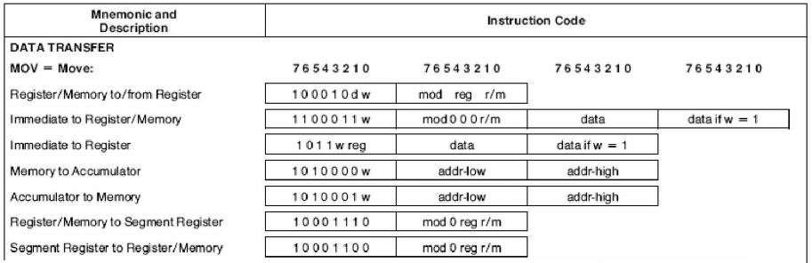
Assembly Language to Machine Code
Description of MOV instruction
from 8086/88 datasheet
(R / M to/from R)
Register to Register
Register from Register
Memory to Register
Memory from Register
Computer Science & Information Technology Department
Sir Syed University of Engg. & Tech.
Lecture by: Mr. Shakir Karim

Slide 4
Assembly Language to Machine Code
OPCODE | D | W | MOD | REG | R/M
BYTE 1
BYTE 2
Computer Science & Information Technology Department
Sir Syed University of Engg. & Tech.
Lecture by: Mr. Shakir Karim

Slide 5
Assembly Language to Machine Code
OPCODE | D | W | MOD | REG | R/M
BYTE 1
BYTE 2
BYTE1: Three fields
Opcode (6 bits) specifies operation (e.g., MOV)
D (Register Direction Bit) specifies whether REG in BYTE 2 is source or destination
D=0 means REG is not destination i.e.; it’s source
D=1 means REG is destination
W (Data Size Bit) specifies whether operation to be performed on 8-bits or 16-bits
W=0 means 8-bits register
W=1 means 16-bits register
Computer Science & Information Technology Department
Sir Syed University of Engg. & Tech.
Lecture by: Mr. Shakir Karim

Slide 6
Assembly Language to Machine Code
OPCODE | D | W | MOD | REG | R/M
BYTE 1
BYTE 2
BYTE2: Three fields
MOD (2 bits) specifies addressing mode
REG (3 bits) specifies registers as operand
R/M (3 bits) specifies whether the data is accessed using register or memory
MOD and R/M both specify the second operand
Computer Science & Information Technology Department
Sir Syed University of Engg. & Tech.
Lecture by: Mr. Shakir Karim

Slide 7
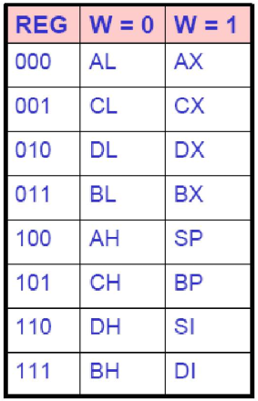
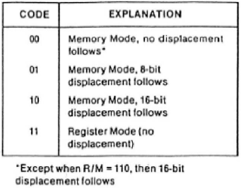
Assembly Language to Machine Code
2-bits of MOD field
Computer Science & Information Technology Department
Sir Syed University of Engg. & Tech.
Lecture by: Mr. Shakir Karim

Slide 8
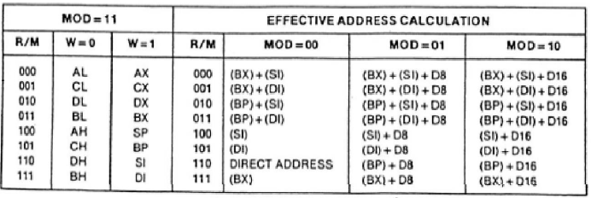
Assembly Language to Machine Code
2-bits MOD and 3-bits R/M
specify the destination operand
Values for Register addressing are equal
Register Addressing
Memory Addressing
Computer Science & Information Technology Department
Sir Syed University of Engg. & Tech.
Lecture by: Mr. Shakir Karim

Slide 9
Assembly Language to Machine Code
Description of MOV instruction
from 8086/88 datasheet
Computer Science & Information Technology Department
Sir Syed University of Engg. & Tech.
Lecture by: Mr. Shakir Karim

Slide 10
Assembly Language to Machine Code
Example: MOV BL, AL
(Register to Register addressing)
Opcode of MOV is 100010
Source is a register so D = 0
8-bits data transfer so W = 0
REG table suggests 000 for AL
MOD is 11 since it is register addressing mode
R/M is 011
Thus, Machine instruction for MOV BL, AL is
10001000 11000011
NOTE: When both soruce and destination are registers then consider REG as SOURCE
OPCODE 100010 | D 0 | W 0 | MOD 11 | REG 000 | R/M 011
OPCODE 100010 | D | W | MOD | REG | R/M
Computer Science & Information Technology Department
Sir Syed University of Engg. & Tech.
Lecture by: Mr. Shakir Karim

Slide 11
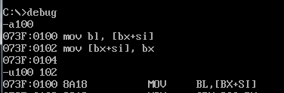
Assembly Language to Machine Code
Example: MOV BL, [BX+SI]
(Memory to Register addressing)
Opcode of MOV is 100010
Register is a Destination so D = 1
8-bits data transfer so W = 0
REG table suggests 011 for BL
MOD is 00 since it is memory addressing mode
without displacement
R/M is 000
Thus, Machine instruction for MOV BL, [BX+SI] is
1000101000011000 = 8A18
OPCODE 100010 | D 1 | W 0 | MOD 00 | REG 011 | R/M 000
Computer Science & Information Technology Department
Sir Syed University of Engg. & Tech.
Lecture by: Mr. Shakir Karim

Slide 12
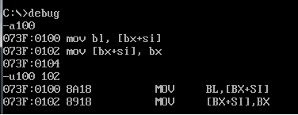
Assembly Language to Machine Code
Example: MOV [BX+SI], BX
(Register to Memory addressing)
Opcode of MOV is 100010
Register is a source so D = 0
16-bits data transfer so W = 1
REG table suggests 011 for BX
MOD is 00 since it is memory addressing mode
without displacement
R/M is 000
Thus, Machine instruction for MOV [BX+SI], BXis
1000100100011000 = 8918
OPCODE 100010 | D 0 | W 1 | MOD 00 | REG 011 | R/M 000
Computer Science & Information Technology Department
Sir Syed University of Engg. & Tech.
Lecture by: Mr. Shakir Karim

